Slide 1
Hudson River Housing 2023 Data
Alesio Dosti, Audrey Myers, Ian Zumpano

Slide 2

Hudson River Housing
“Hudson River Housing improves lives and communities through housing with compassion and development with vision.”
Affordable housing
Emergency housing
Transitional housing (affordable rent, intended 24 months or less)
Permanent supportive housing
Support services
Community building/development

Slide 3
Introduction
Data Source:
HMIS (Homeless Management Information System)
Data for all individuals in system in 2023
Goals:
Visualize demographics of guests/residents served by HRH
Look at length of program stay across programs and identify factors that are associated with longer/shorter stays
Explore where data is more and less complete

Slide 4
Demographic Data

Slide 5
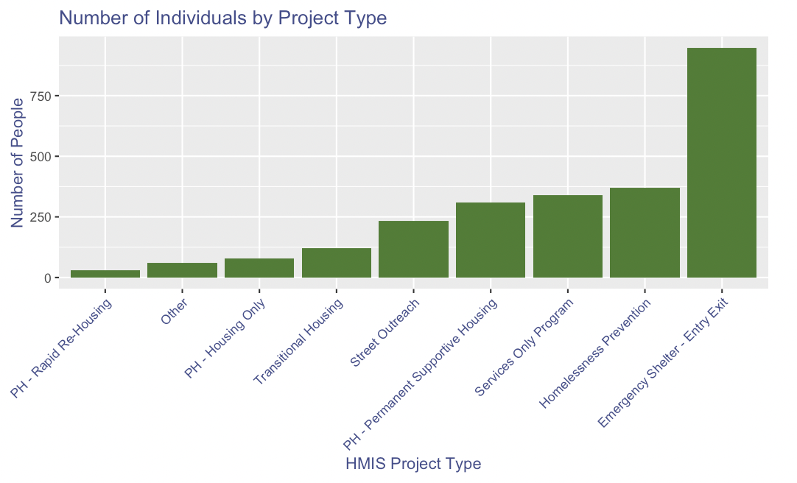
Notes:
This plot shows the distribution of HRH residents throughout the different HMIS project types.

Slide 6
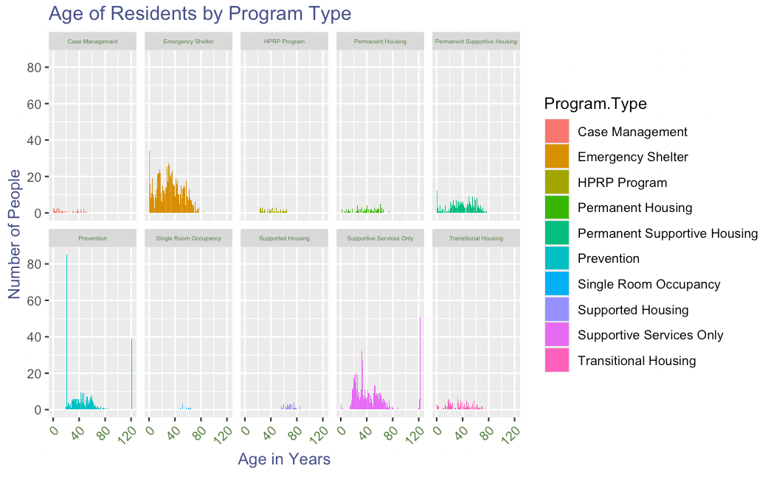
Notes:
These ten different plots show the distribution of residents’ ages in each of the program types. You can notice trends by seeing spikes in certain age ranges for different program types.

Slide 7
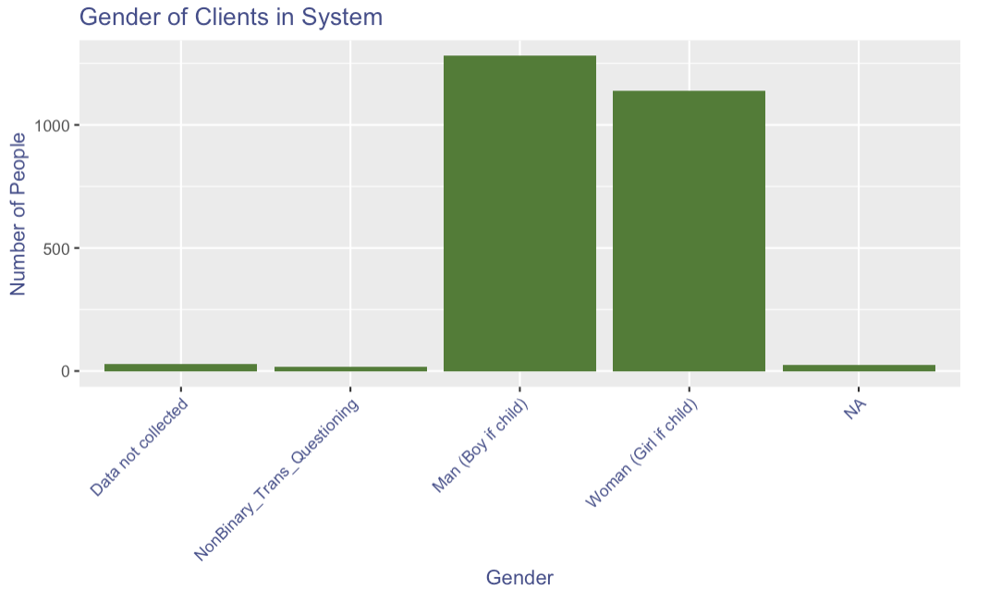
Notes:
This bar plot shows the distribution of HRH residents by gender in the HMIS system. NA in this graph represents no input.

Slide 8
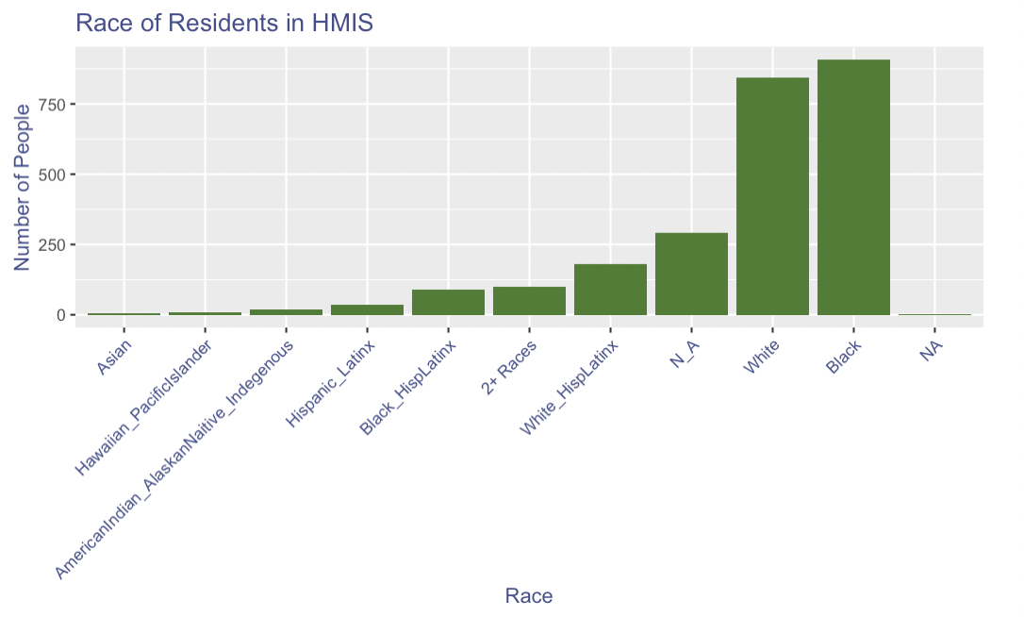
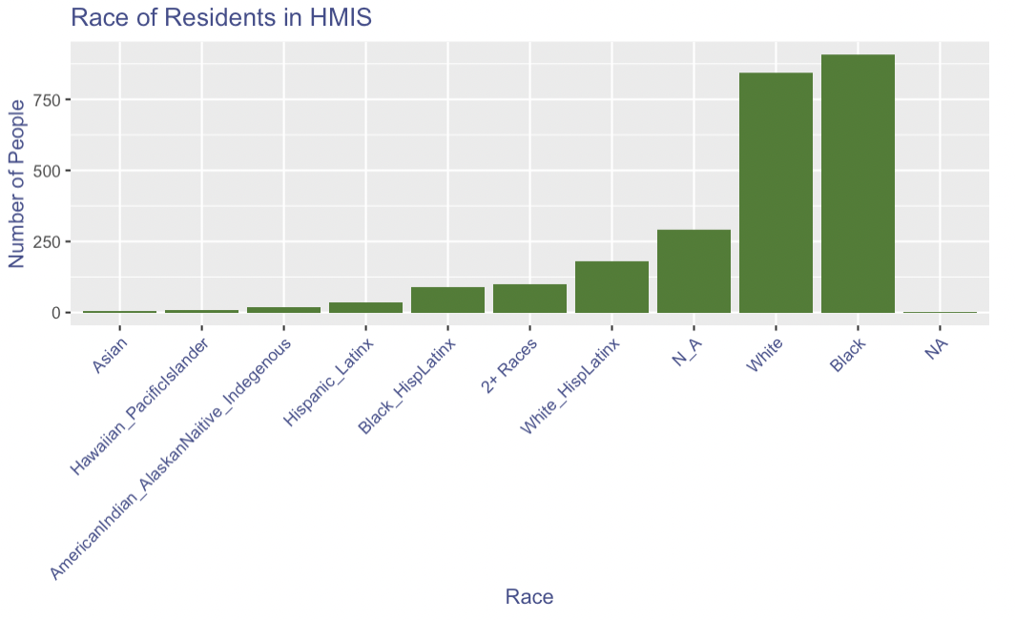
Notes:
The plot above displays the distribution of race among residents in HRH in increasing order.

Slide 9
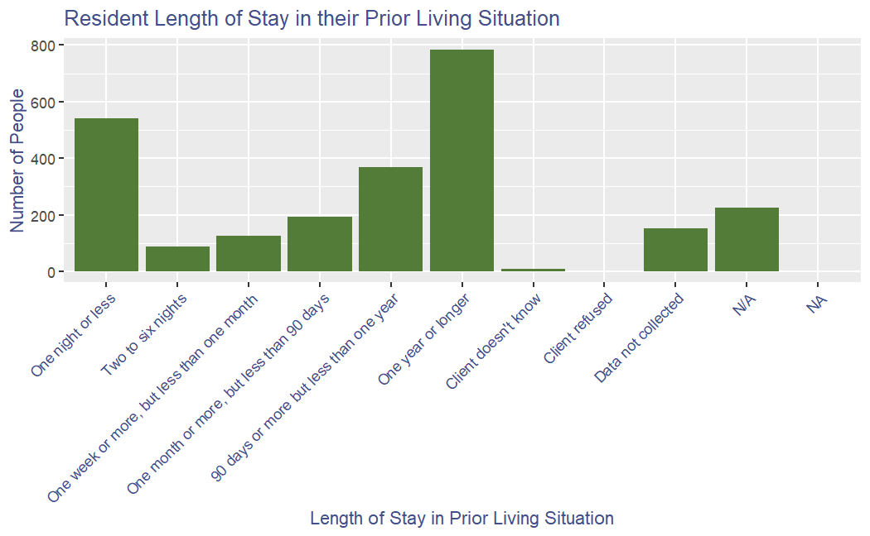
Notes:
This plot shows the resident length of stay in their prior living situation. There are 6 different length of stay periods ranging from one night or less to one year or longer. You can see the two ranges with the highest number of residents being “one night or less” and “one year or longer”. N/A represents residents who inputted NA in the questionnaire.

Slide 10
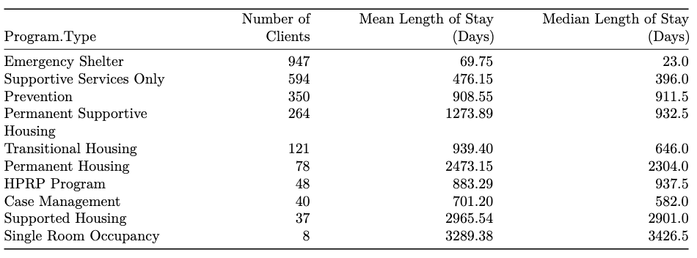
Length of stay by program type

Slide 11
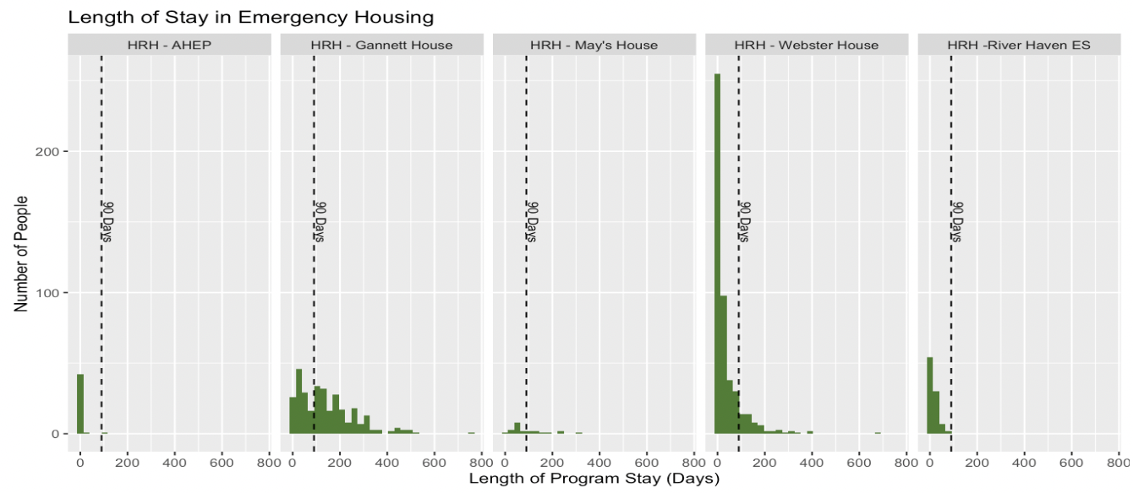
Notes:
These next plots focus are histograms focusing on length of stay within shorter-term programs. Each of the boxes represents a specific program/location. There's a dotted line at the 90 day mark, indicating the "ideal" time by which a guest would be discharged from emergency to longer term/more stable housing. Webster House and River Haven do fairly well in that regard; Gannett House has a noticeably higher spread. This is interesting because in contrast to the other programs, Gannett House is emergency housing for families.

Slide 12
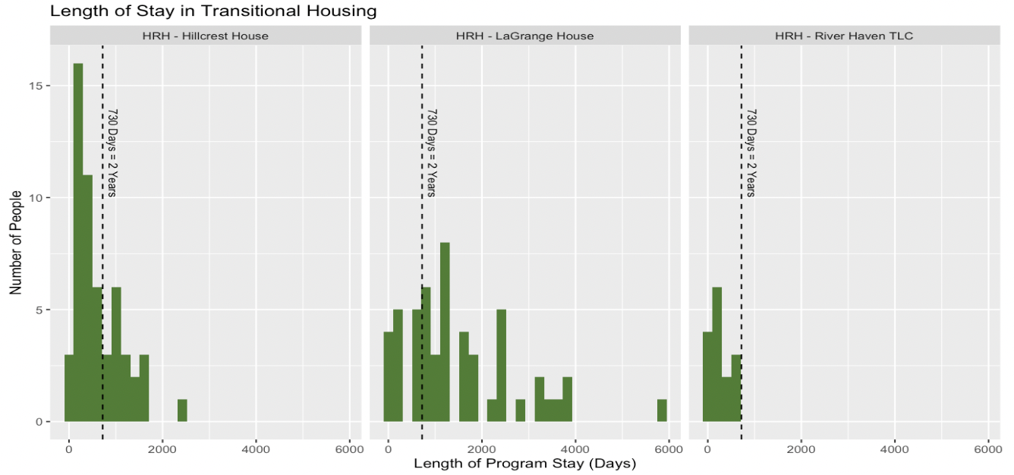
Notes:
Within transitional housing, there is a similar pattern. Here, the dotted line marks 2 years, the intended maximum length of stay as defined by HUD, although exceptions are allowed. LaGrange, transitional housing for families has a comparatively higher spread of length of stay relative to the programs for individuals. These higher lengths of stay are in line with observations that it's much harder to find affordable housing for families compared to for individuals.

Slide 13
Modeling Length of Stay

Slide 14
Modeling Length of Program Stay
Length of Program Stay: how long client has been in current program (how long living in emergency, transitional or permanent housing)
Are there factors associated with people staying longer/shorter than programs intend?
Hypotheses:
Transience: Length of stay in prior living situation
Chronic homelessness
→ more difficulty finding/maintaining housing?
→ reflected in length of stay?
Notes:
In the modeling section, we explore any characteristics that may be associated with length of program stay. We focused on three housing types- emergency transitional and permanent supportive housing, fitting a separate model for each.
We explored many variables looking for a relationship. Based on this exploration, degree of completeness, and outside information, we hypothesized that transience, if an individual has stayed for shorter periods of time in their prior living situations, might continue into the present- this is represented in the data as the “length of stay in prior living situation” variable. We also included chronic homelessness in the models.

Slide 15
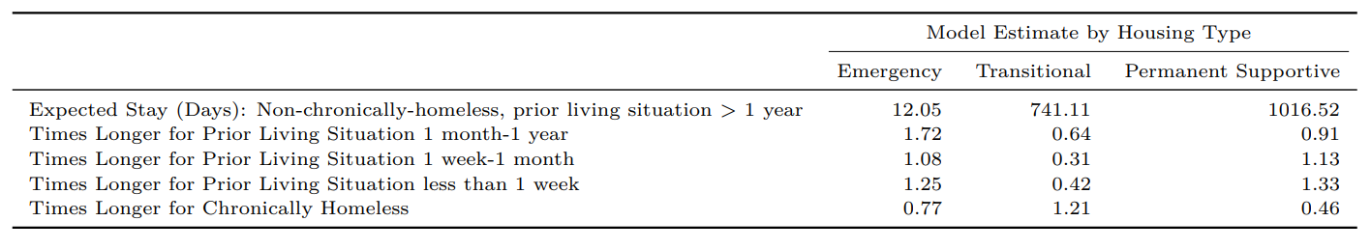
Modeling Length of Program Stay: Linear Regression Model
Missing values excluded
Length of stay skewed → log transformation
Lines 2-5: greater than 1 = longer length of stay compared to an individual who is non-chronically homeless with length of stay in prior living situation > 1 year
Less than one: shorter relative length of stay
More transient → shorter term stays in current program within transitional housing
Chronic homelessness → shorter lengths of stay in permanent housing
Notes:
We fit 3 separate linear regression model with these predictors.
Since program stay is skewed (most values are lower, with few very high values), we did a log transformation. Because of this, interpreting the results can be more difficult, but the most interesting and significant results are the following. Higher transience, as indicated by lower length of stay in prior living situation, is associated with shorter expected stays within transitional housing in the model, but not so clearly so within emergency and permanent supportive housing. Another result was that within permanent supportive housing, the expected length of stay for someone who is chronically homeless is half that of someone who is not, adjusting for prior living situation. These results demonstrate how data may be able to capture some of the ways in which residents' backgrounds play a role in their experiences in these programs.

Slide 16
Data Completeness

Slide 17
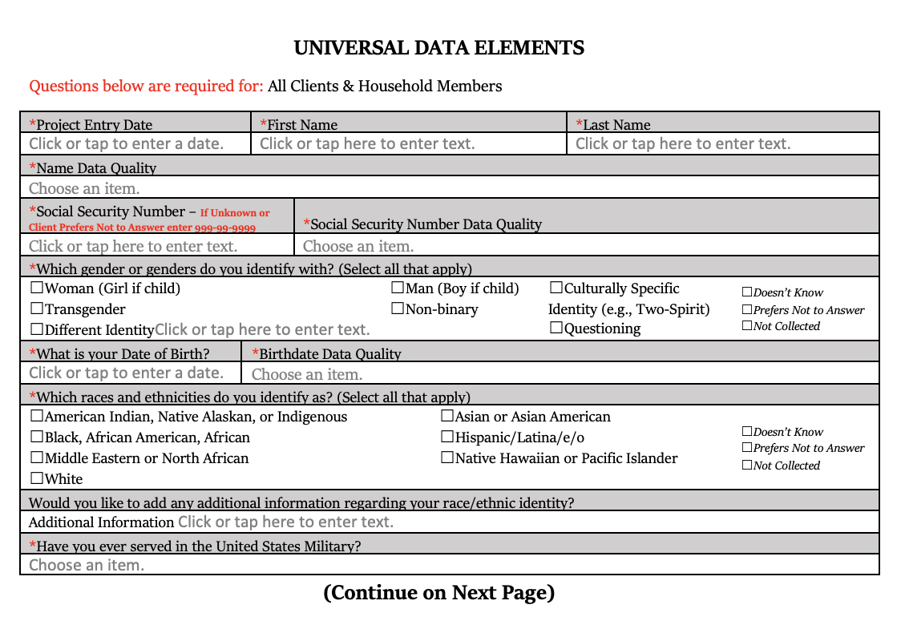
Intake Form And Universal Data Elements

Slide 18
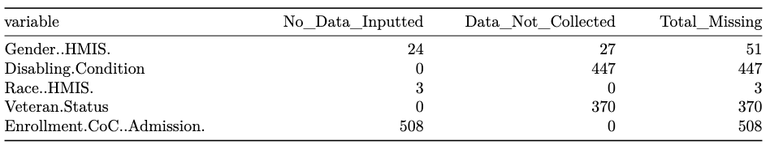
Missing Data: Universal Data Elements
What are Universal Data Elements (UDEs)?
HMIS Universal Data Elements are elements required to be collected during intake, mandated by H.U.D.
Includes SSN, birthday, and other identifying information as well as questions surrounding demographics and living history

Slide 19
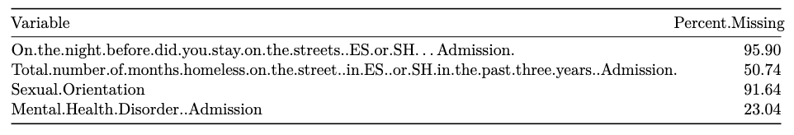
Recommendations for Prioritization of Variables
Additional Recommendations:
Standardization of entry of missing variable for age and other UDEs
Additional variable to measure success of outcome at discharge
Notes:
Additional variable to measure positive or negative outcomes- defining outcomes would allow for calculation of the rates of these positive/negative outcomes, and comparisons can be made to inform where more or different kinds of support may be needed.

Slide 20
Conclusions

Slide 21
Takeaways
Data analysis can provide quantitative support for observations and experience of those who work in the system on a daily basis
Data and data visualization can serve as tools to communicate with the general public
Standardization of data collection going forward can help guide the transition towards being more data driven

Slide 22
Acknowledgements
We would like to thank Hudson River Housing for giving us the opportunity to work with them this semester and for trusting us with this project.
Special thanks to Javier and Vinny for lending their expertise and taking the time to answer all of our questions.
And thank you to Professor An for organizing this class and for her help and guidance throughout the semester.
Thank you!

Slide 23
Questions?

